Slide 1

Notes:
One of you downloads the Loquiz app on their phones and logs in with the QR-code on the screen. Make sure you give Loquiz access to all the information it needs.

Slide 2
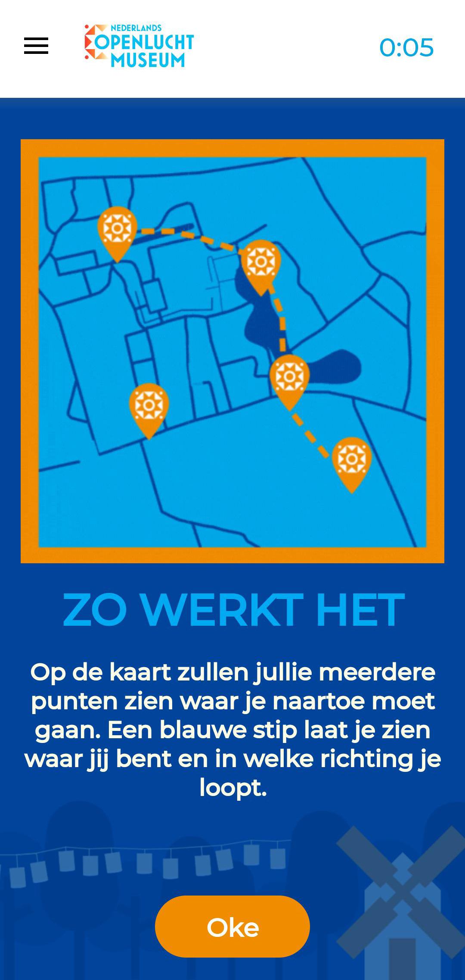

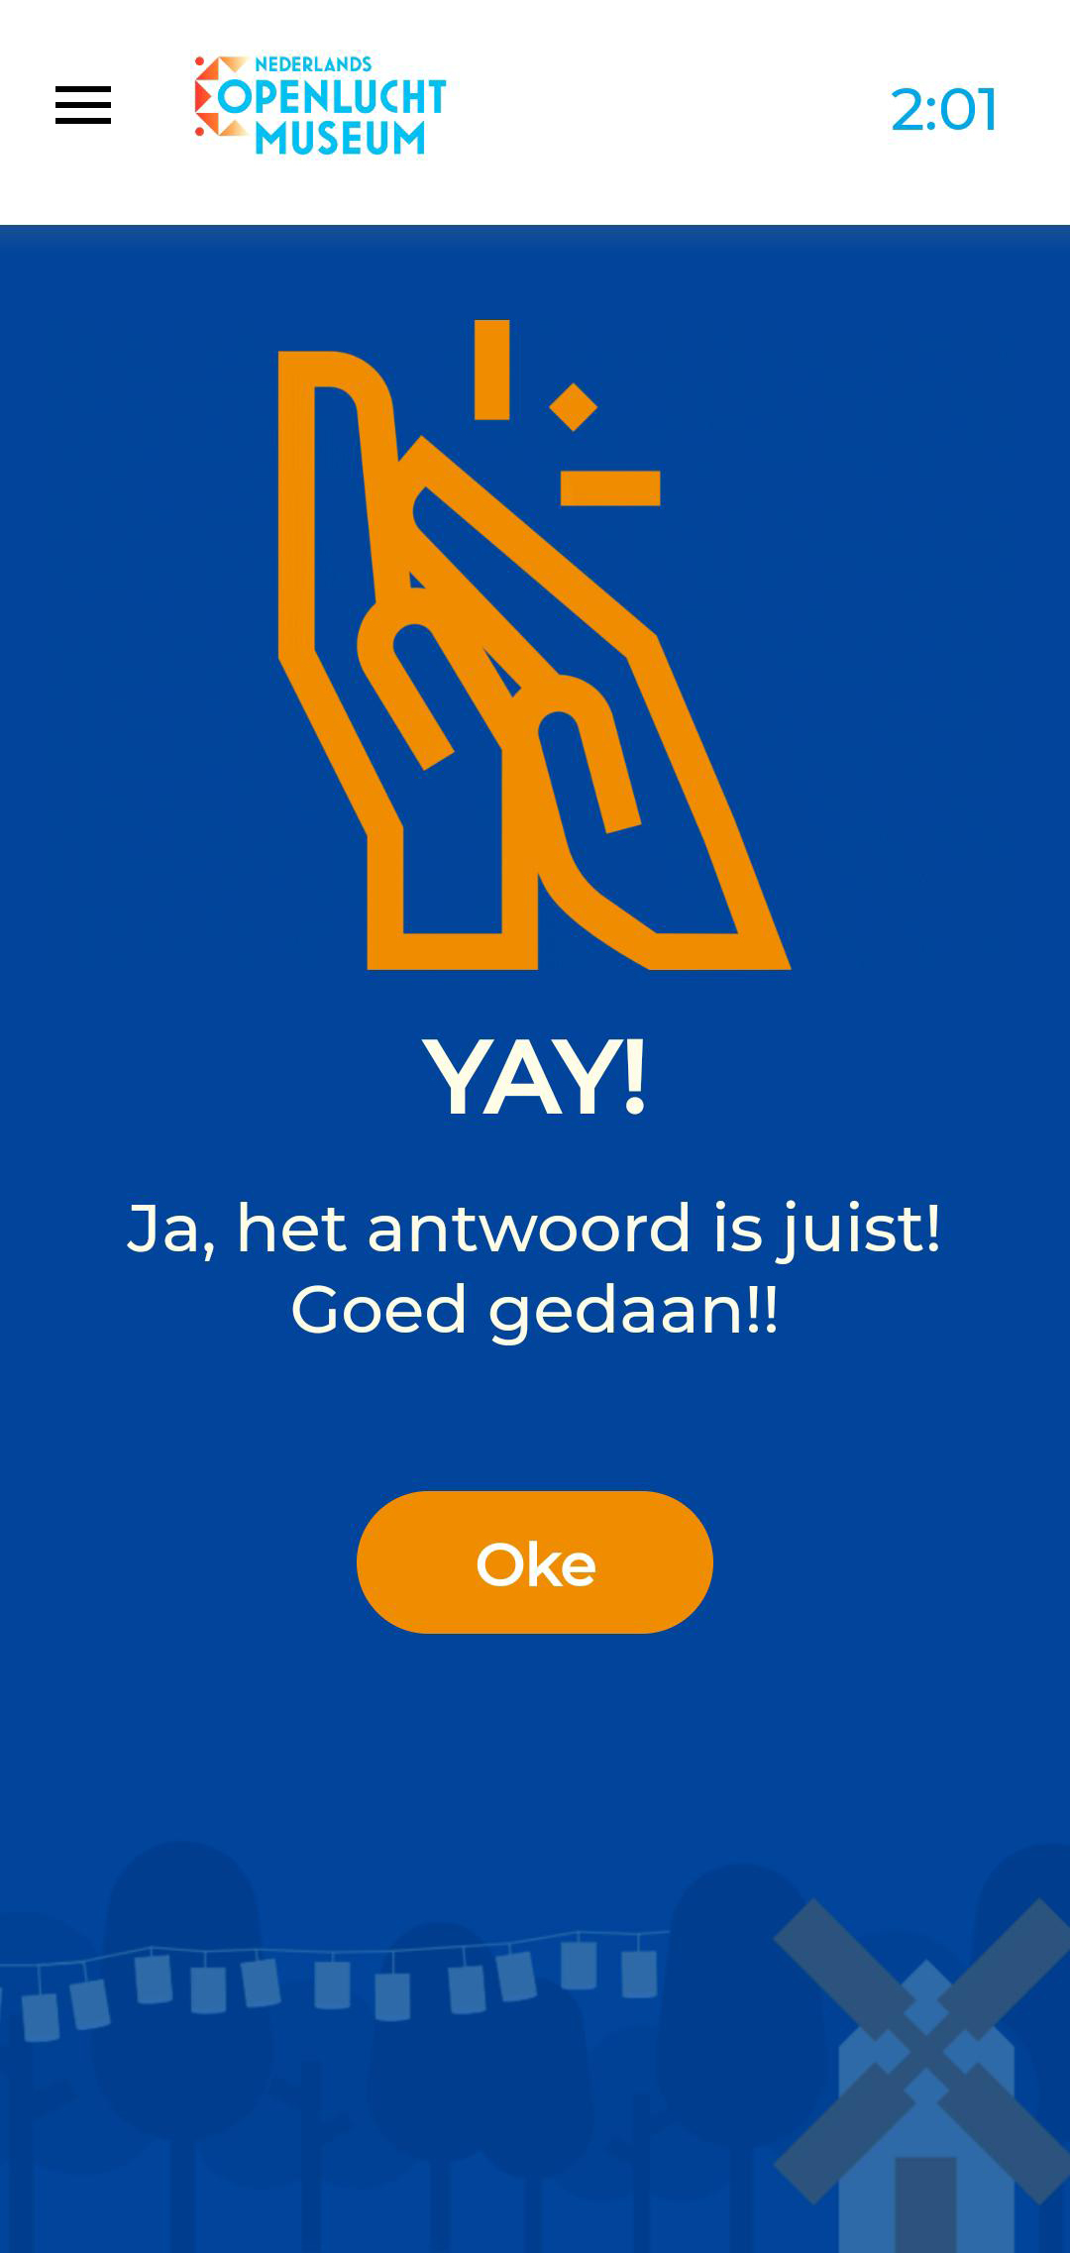
Zo werkt het
Navigeer naar de “pins”
Beantwoord de vragen
Scoor punten
Het team met de meeste punten wint
*Geef Loquiz toegang om het spel te kunnen spelen

Slide 3

Laten we beginnen
Maak teams van 4-5 p.
Één teamlid download de LOQUIZ app (Playstore/Appstore)
*Geef Loquiz toegang om het spel te kunnen spelen

Slide 4
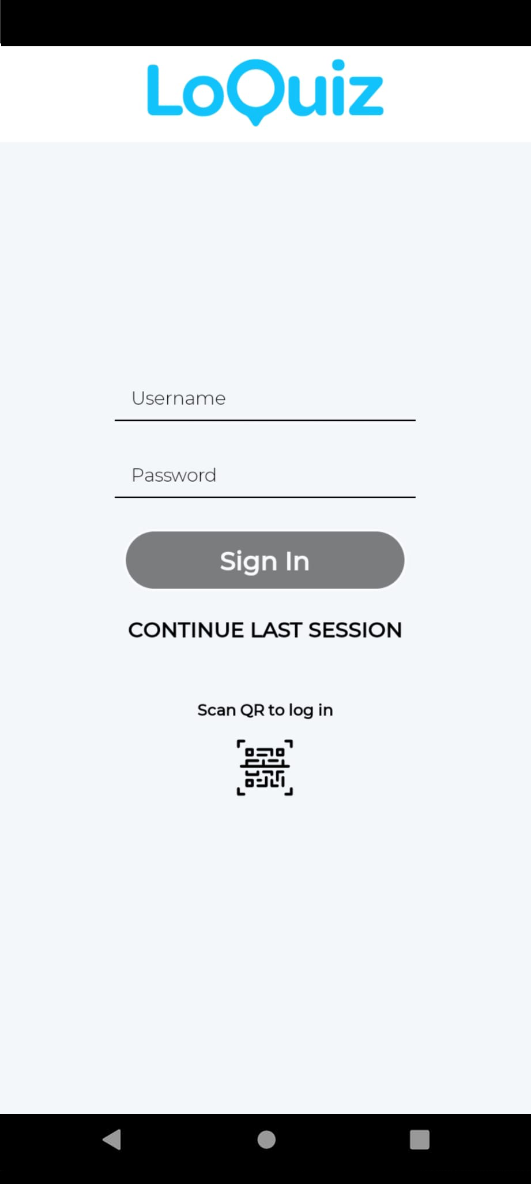

Scan & Start
Username: <plak>
Password: <plak>
Scan de QR code met de Loquiz app
Ga naar buiten en volg de instructies in het spel
Houd de timer in de gaten
Notes:
One of you downloads the Loquiz app on their phones and logs in with the QR-code on the screen. Make sure you give Loquiz access to all the information it needs.

Slide 5
Notes:
One of you downloads the Loquiz app on their phones and logs in with the QR-code on the screen. Make sure you give Loquiz access to all the information it needs.

Slide 6
Link Results

