Slide 1

Notes:
One of you downloads the Loquiz app on their phones and logs in with the QR-code on the screen. Make sure you give Loquiz access to all the information it needs.

Slide 2
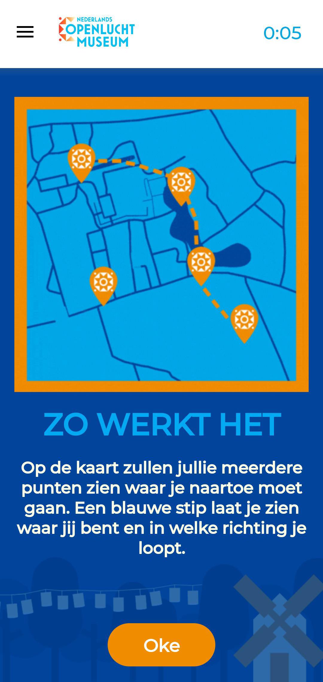


This is how it works
Navigate to the ‘pins’
Answer the questions
Score points
The team with the most points wins
*Give Loquiz access to play the game

Slide 3

Let’s start
Create teams of 4-5 p.
One team member downloads the LOQUIZ app (Playstore/Appstore)
*Give Loquiz access to play the game

Slide 4
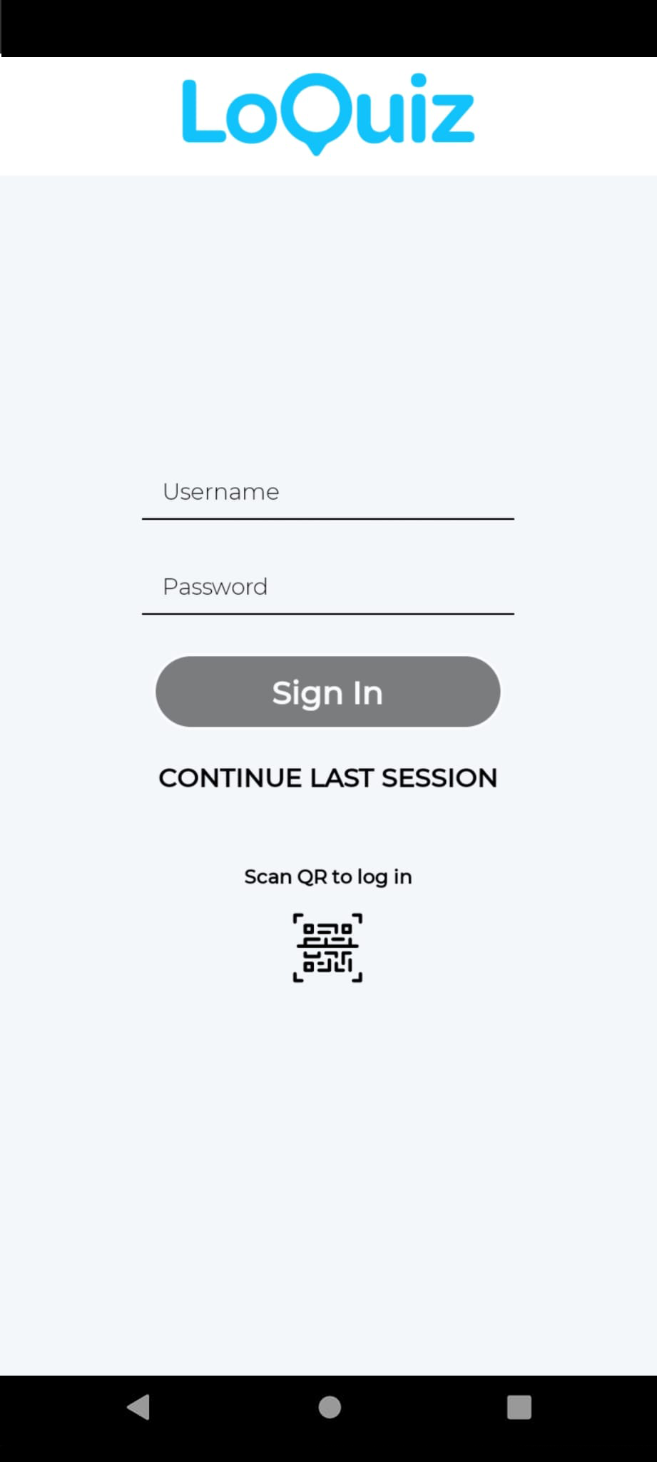

Scan & Start
Username: <plak>
Password: <plak>
Scan the QR code with the Loquiz app
Go outside and follow the instructions in the game
Keep an eye on the timer
Notes:
One of you downloads the Loquiz app on their phones and logs in with the QR-code on the screen. Make sure you give Loquiz access to all the information it needs.

Slide 5
Notes:
One of you downloads the Loquiz app on their phones and logs in with the QR-code on the screen. Make sure you give Loquiz access to all the information it needs.

Slide 6
Link Results

