Slide 1

Notes:
One of you downloads the Loquiz app on their phones and logs in with the QR-code on the screen. Make sure you give Loquiz access to all the information it needs.

Slide 2
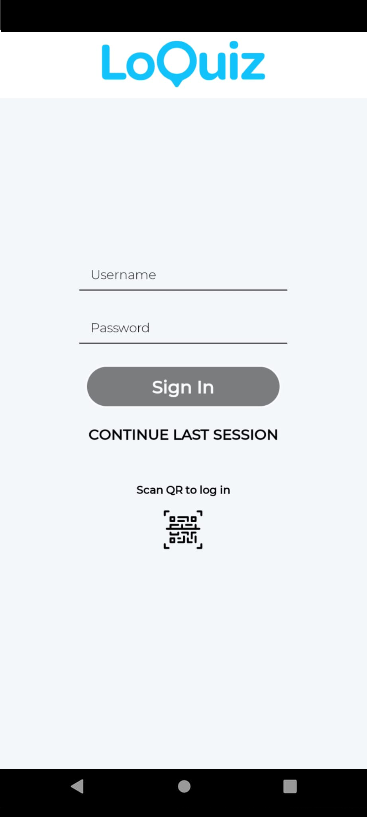
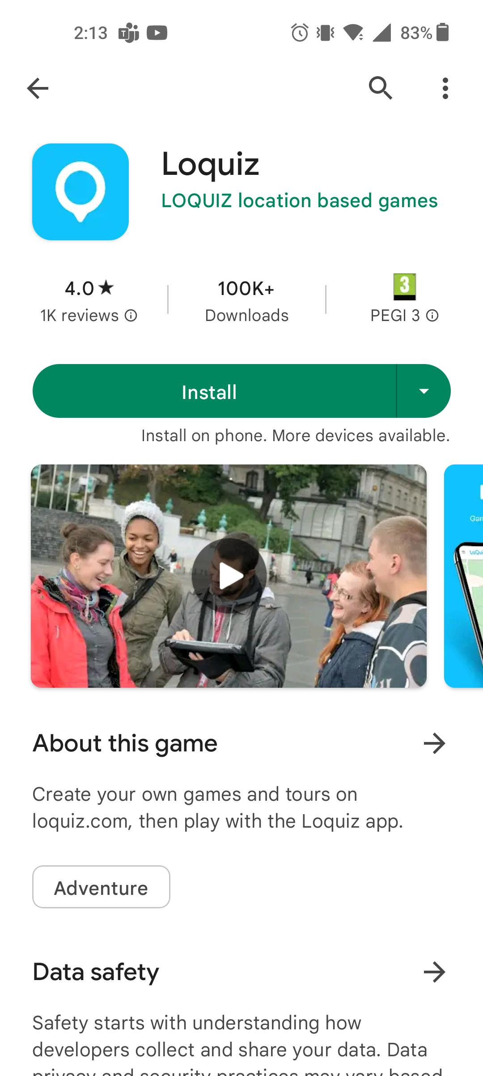

Download!
Find your team
One team member downloads the LOQUIZ app. (PlayStore/AppStore)
*Give Loquiz access to play the game

Slide 3
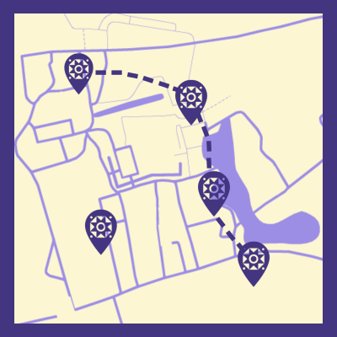
Let's get started!
Scan the QR code
Enter your team name
Go outside and follow the in-game instructions
Have fun!
Notes:
One of you downloads the Loquiz app on their phones and logs in with the QR-code on the screen. Make sure you give Loquiz access to all the information it needs.

Slide 4

Let's get started!!
Username: [Replace]
Password: [Replace]
Scan the QR code
Enter your team name
Go outside and follow the in-game instructions
Have fun!
Notes:
One of you downloads the Loquiz app on their phones and logs in with the QR-code on the screen. Make sure you give Loquiz access to all the information it needs.

Slide 5
Notes:
One of you downloads the Loquiz app on their phones and logs in with the QR-code on the screen. Make sure you give Loquiz access to all the information it needs.

Slide 6
Link Results

